Slide 1
Hollymount School
2015-2016
EAL
Vocabulary
Book
(Term 1)

Slide 2
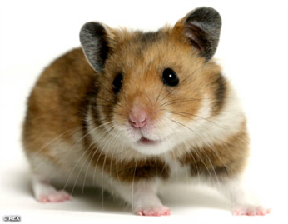
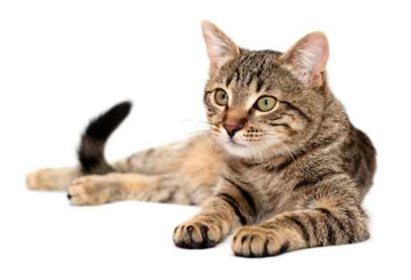
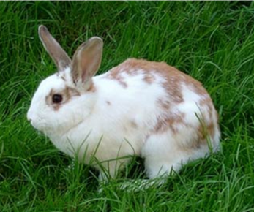
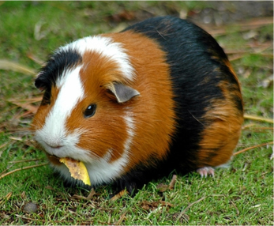
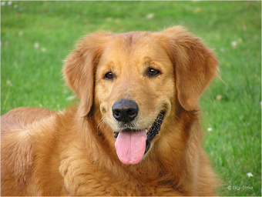
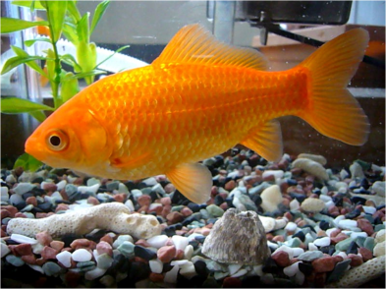
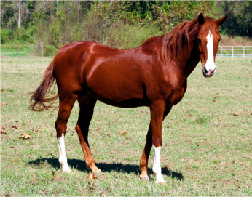
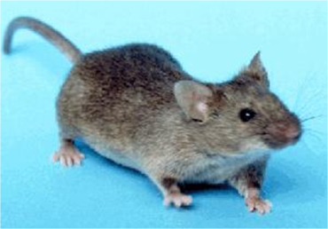
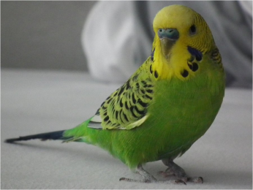
Pets
English
I like | Lubię | Eu gosto | man patinka | Îmi place
I love | kocham | Eu amo | Aš myliu | Îmi place
I don’t like | Nie podoba mi się | Eu não gosto | Man nepatinka | Nu-mi place
I hate | Nienawidzę | odeio | Aš nekenčiu | Nu-mi place
rabbit
cat
dog
hamster
guinea pig
fish
mouse
budgie
rat
horse

Slide 3
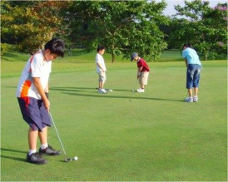
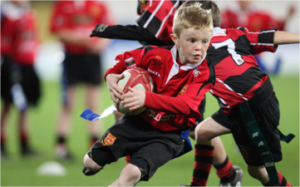
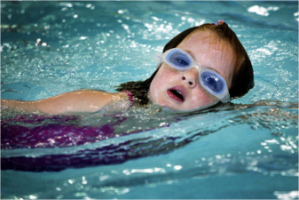
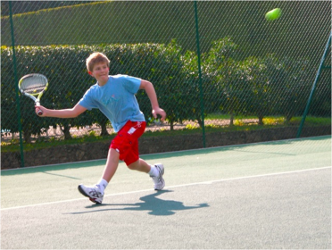
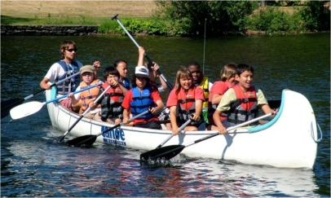
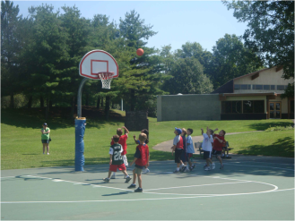
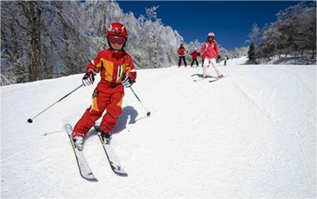
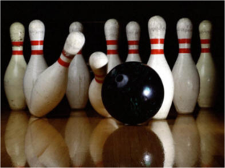
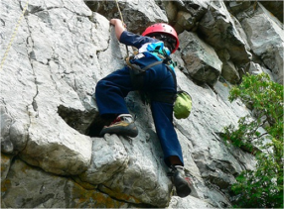
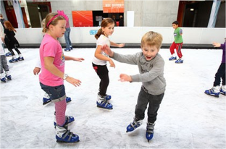
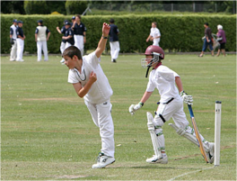
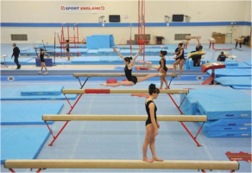
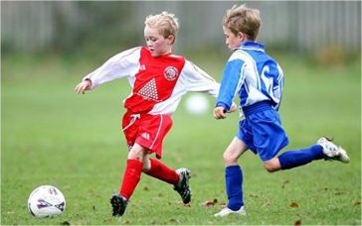
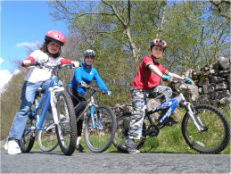
Sports
English
I like | Lubię | Eu gosto | man patinka | Îmi place
I love | kocham | Eu amo | Aš myliu | Îmi place
I don’t like | Nie podoba mi się | Eu não gosto | Man nepatinka | Nu-mi place
I hate | Nienawidzę | odeio | Aš nekenčiu | Nu-mi place
My favourite | Moje ulubione | meu favorito | Mano mėgstamiausia | preferata mea
golf
rugby
swimming
rowing
basketball
skiing
bowling
tennis
gymnastics
football
climbing
skating
cricket

Slide 4
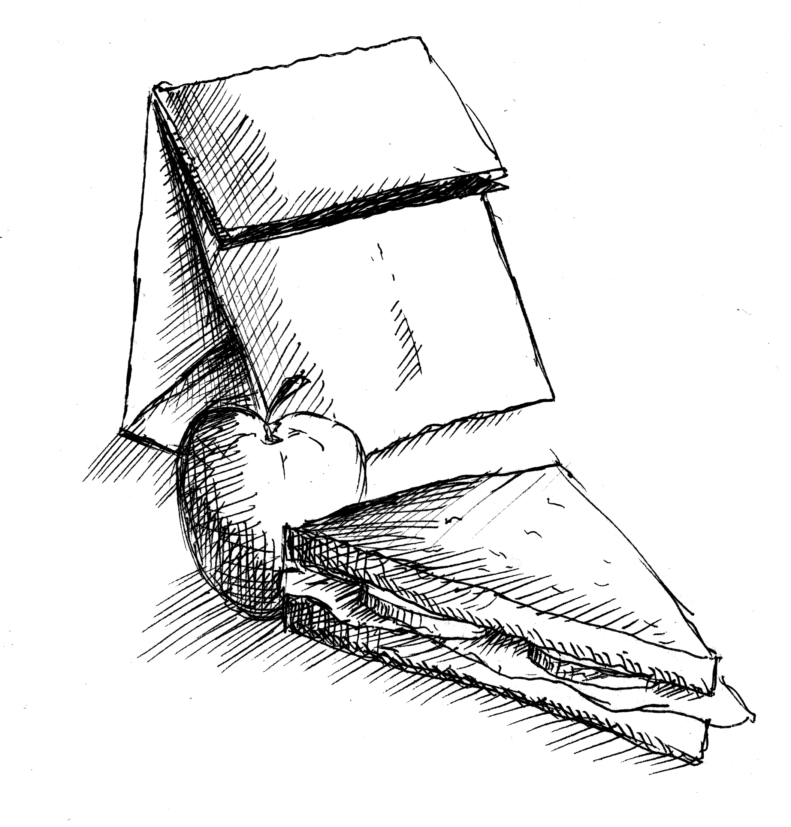
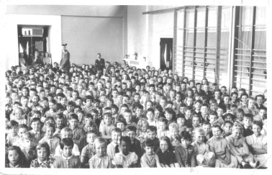
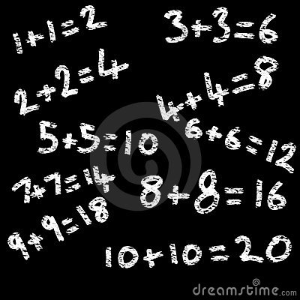
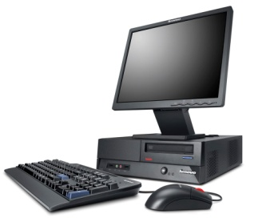
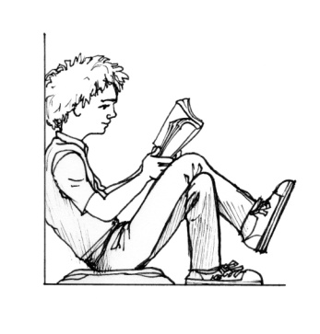
School
English
I like | Lubię | Eu gosto | man patinka | Îmi place
I love | kocham | Eu amo | Aš myliu | Îmi place
I don’t like | Nie podoba mi się | Eu não gosto | Man nepatinka | Nu-mi place
I hate | Nienawidzę | odeio | Aš nekenčiu | Nu-mi place
My favourite | Moje ulubione | meu favorito | Mano mėgstamiausia | preferata mea
lunch
football
assembly
computer
writing
maths
swimming
reading

Slide 5
Days of the Week
English
Monday | poniedziałek | segunda-feira | pirmadienis | luni
Tuesday | wtorek | terça-feira | antradienis | Marți
Wednesday | środa | quarta-feira | trečiadienis | miercuri
Thursday | czwartek | quinta-feira | ketvirtadienis | joi
Friday | piątek | sexta-feira | penktadienis | vineri
Saturday | sobota | sábado | šeštadienis | sâmbătă
Sunday | niedziela | domingo | sekmadienis | duminică
tomorrow
yesterday
jutro
amanhã
rytoj
wczoraj ontem
vakar
day
night

Slide 6
Months of the Year
English
January | styczeń | janeiro | sausis | ianuarie
February | luty | fevereiro | vasaris | februarie
March | marzec | março | kovas | martie
April | kwiecień | abril | balandis | aprilie
May | Maj | maio | gegužės | mai
June | czerwiec | junho | birželis | iunie
July | lipiec | julho | liepa | iulie
August | sierpień | agosto | rugpjūtis | august
September | wrzesień | setembro | rugsėjis | septembrie
October | październik | outubro | spalis | octombrie
November | listopad | novembro | lapkritis | noiembrie
December | grudzień | dezembro | gruodis | decenbrie

Slide 7
Adjectives 1
English
tall | wysoki | alto | aukštas | înalt
short | krótki | curto | trumpas | scurt
big | duży | grande | didelis | mare
small | mały | pequeno | mažas | mic
pretty | ładny | bonito | gražus | frumos
ugly | brzydki | feio | bjaurus | urât
lovely | piękny | encantador | puikus | minunat
horrible | straszny | horrível | baisus | oribil
cute | ładny | bonitinho | mielas | drăguț
friendly | przyjazny | amigável | draugiškas | prietenos
kind | rodzaj | tipo | natūra | fel
nasty | przykry | desagradável | bjaurus | urât
very bardzo
muito
labai
foarte
Quite całkiem
bastante
gana
destul de
sometimes czasami
às vezes
kartais
uneori

Slide 8
Adjectives 2
English
scary | straszny | assustador | baisu | înfricoșător
broken | złamany | quebrado | sulaužytas | rupt
evil | zło | mal | blogis | rău
beautiful | piękny | belo | gražus | frumos
magical | magiczny | mágico | magiškas | magic
amazing | zdumiewający | surpreendente | nuostabus | uimitor
happy | szczęśliwy | feliz | laimingas | fericit
sad | smutny | triste | liūdnas | trist
weird | upiorny | estranho | keistas | ciudat
clever | mądry | inteligente | protingas | inteligent
colourful | kolorowy | colorido | spalvingas | colorat
naughty | niegrzeczny | desobediente | išdykęs | obraznic

Slide 9
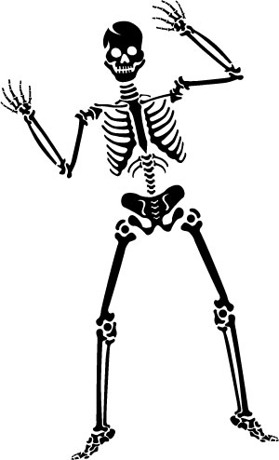
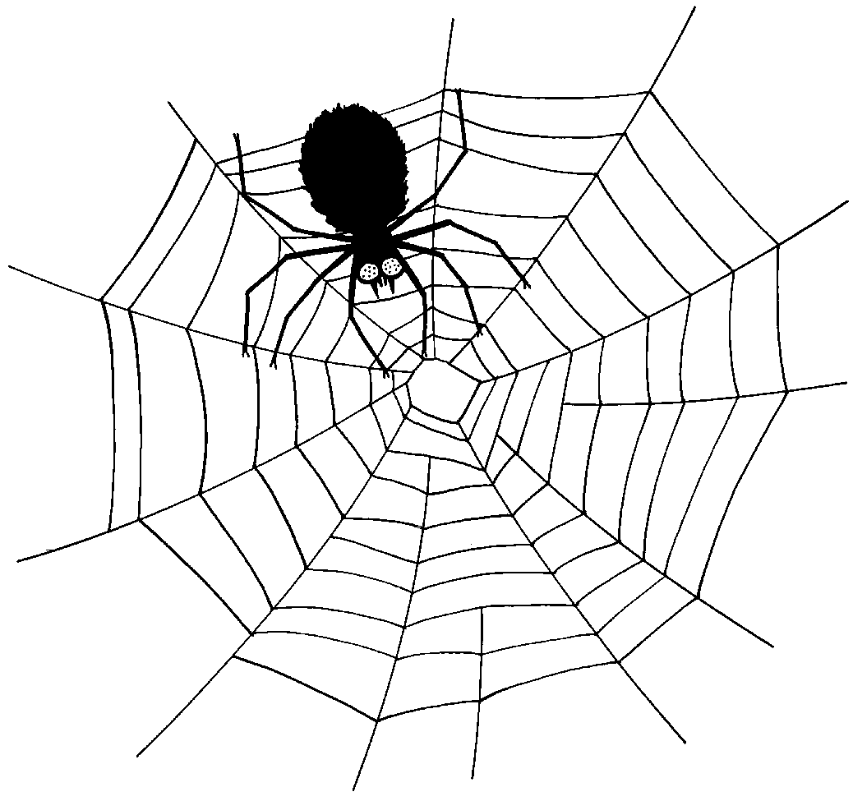
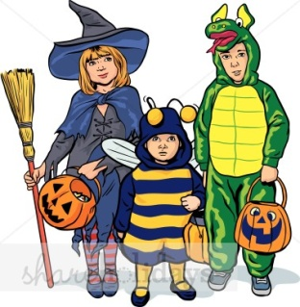
Halloween
pumpkin
ghost
spider
witch
skeleton
bat
costumes
haunted
house
vampire
sweets

Slide 10
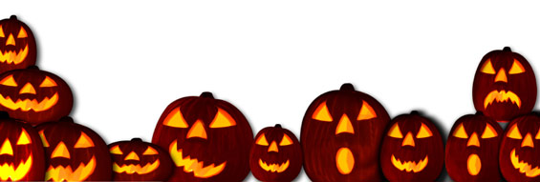
eye
head
hand
nose
elbow
mouth
arm
neck
leg
knee
ankle
foot

Slide 11
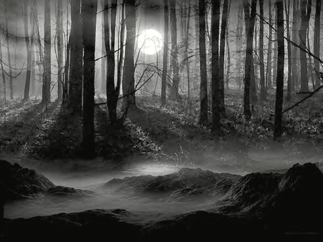
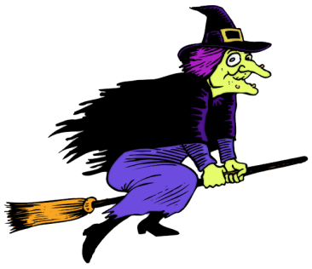
evil
haunted
wicked
ghostly
spooky
hideous
creepy
sinister
mysterious
frightening
scary
weird
eerie

Slide 12
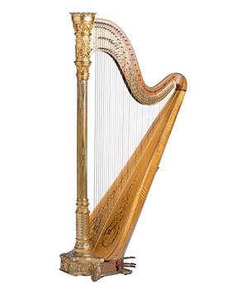
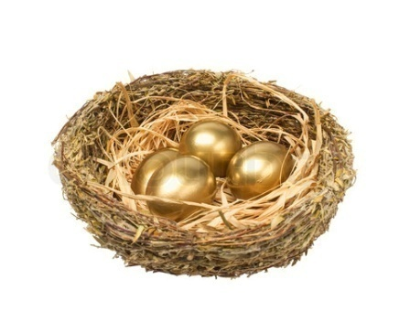
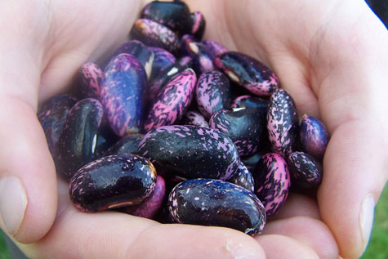
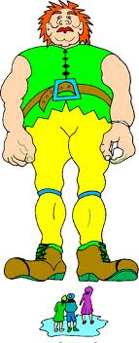
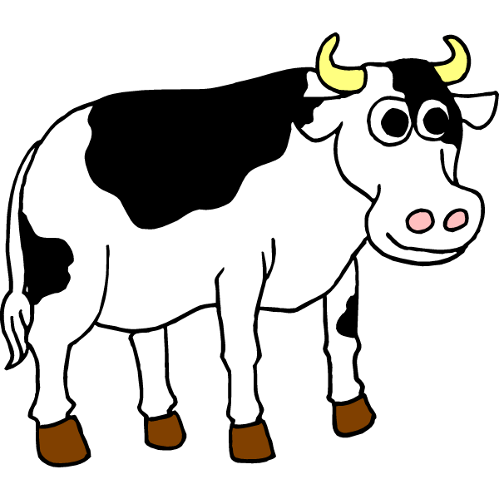
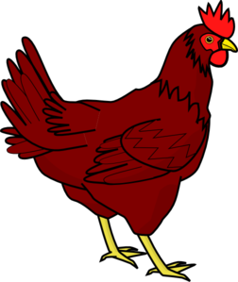
Jack & the Beanstalk
axe
magic beans
golden eggs
beanstalk
harp
hen
castle
cow
giant

Slide 13
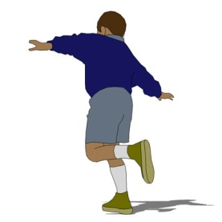
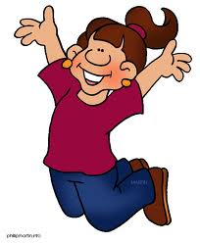
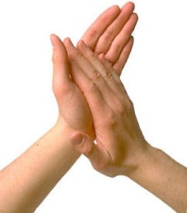
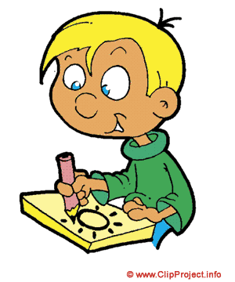
Verbs
English
hop | chmiel | salto | šokinėti | salt
jump | skakać | saltar | šokinėti | sari
clap | klaskać | aplaudir | triperis | aplauda
skip | pomijać | pular | praleisti | sări
walk | spacer | andar | vaikščioti | mers pe jos
run | biegać | correr | paleisti | alerga
kick | kopać | chutá | ateityje | lovitură
read | czytać | ler | skaityti | citit
write | pisać | escrever | rašyti | a scrie
draw | rysować | desenhar | atkreipti | trage
sing | śpiewać | cantar | dainuoti | cânta
drive | jechać | conduzir | vairuoti | conduce
skip
hop
jump
clap
walk
run
draw
drive

Slide 14
Opposites 1
English
fast | szybko | rápido | rapid | greitai
slow | powolny | devagar | lent | lėtas
push | naciskać | empurrar | împinge | stumti
pull | ciągnąć | puxar | trage | traukti
loud | głośno | alto | tare | garsiai
quiet | cichy | calma | liniștit | ramus
soft | miękki | suave | moale | minkštas
hard | ciężko | difícil | greu | sunkus
happy | szczęśliwy | feliz | fericit | laimingas
sad | smutny | triste | trist | liūdnas
good | dobry | bom | bun | geras
bad | zły | ruim | rău | blogas

Slide 15
Opposites 2
English
hot | gorąco | quente | fierbinte | karštas
cold | zimno | frio | rece | šaltas
night | noc | noite | noapte | naktis
day | dzień | dia | zi | diena
up | w górę | para cima | sus | į viršų
down | w dół | para baixo | jos | žemyn
clean | czyścić | limpar | curat | švarus
dirty | brudny | sujo | murdar | purvinas
long | długo | longo | lung | ilgai
short | krótki | curto | scurt | trumpas
empty | pusty | vazio | gol | tuščias
full | pełny | completo | complet | pilnas

Slide 16
Opposites 3
English
big | duży | grande | mare | didelis
small | mały | pequeno | mic | mažas
in | w | em | în | į
out | na zewnątrz | fora | afară | iš
young | młody | jovem | tineri | jaunas
old | stary | velho | vechi | senas
left | lewa | esquerda | stânga | į kairę
right | prawo | direito | dreapta | teisė
high | wysoki | alto | mare | aukštas
low | niski | baixo | scăzut | žemas
tidy | schludny | arrumado | ordonat | tvarkingas
messy | niechlujny | confuso | murdar | nepatogus

Slide 17
Opposites 4
English
thick | gruby | grosso | gros | storas
thin | cienki | fino | subțire | plonas
open | otwarte | aberto | deschis | atviras
closed | zamknięte | fechado | închis | uždarytas
wet | mokro | molhado | umed | šlapias
dry | suchy | seca | uscat | sausas
love | miłość | amor | dragoste | meilė
hate | nienawidzić | ódio | ură | nekęsti
right | prawo | direito | dreapta | teisė
wrong | źle | errado | greșit | blogai
sun | słońce | sol | soare | saulė
moon | księżyc | lua | lună | mėnulis

Slide 18
Emotions 1
English
happy | szczęśliwy | feliz | laimingas | fericit
sad | smutny | triste | liūdnas | trist
scared | przerażony | assustado | išsigandęs | speriat
angry | zły | zangado | piktas | supărat
shy | nieśmiały | timido | drovus | timid
excited | podekscytowany | animado | susijaudinęs | excitat
nervous | nerwowy | nervoso | nervų | nervos
calm | spokojna | calma | ramus | calm
tired | zmęczony | cansado | pavargęs | obosit
bored | znudzony | entediado | nuobodu | plictisit
confused | zmieszany | confuso | sumišęs | confuz
proud | dumny | orgulhoso | didžiuojuosi | mândru
excited
happy
sad
tired
scared
angry

Slide 19
Emotions 2

Slide 20
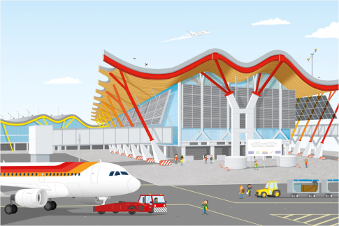
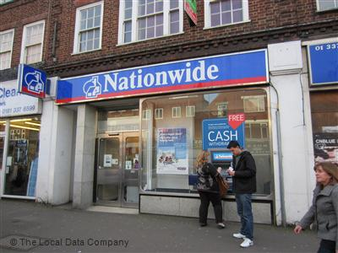
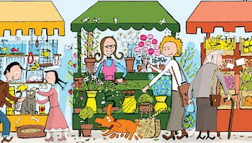
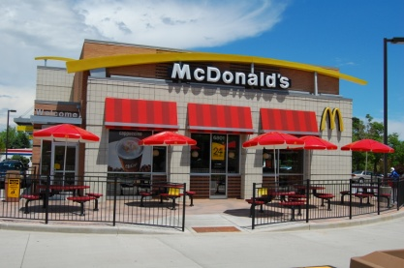
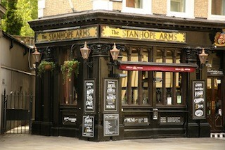
Town
church
flats
hospital
hotel
airport
petrol station
shops
house
bank
market
restaurant
pub

Slide 21
Adjectives describing buildings
English
old | stary | velho | senas | vechi
new | nowy | novo | naujas | nou
modern | nowoczesny | moderno | modernus | modern
ancient | starożytny | antigo | senovės | antic
big | duży | grande | didelis | mare
small | mały | pequeno | mažas | mic
fun | zabawa | diversão | malonumas | distracţie
boring | nudny | chato | nuobodus | plictisitor
strange | dziwny | estranho | keistas | ciudat

Slide 22
Buildings
inside
wewnątrz
dentro
viduje
interior
roof
brick
chimney
window
outside
zewnętrzny
exterior
išorė
exterior
door
attic
bedroom
bathroom
living room/lounge
kitchen

Slide 23
A House
chimney
roof
house
number
window
garden
path
door

Slide 24
Christmas 1
wreath
holly
bauble
tree
Santa
Father Christmas
snowflake
candle
present
gift
star
reindeer
Santa hat
tinsel
sleigh
card
stocking

Slide 25
Christmas 2
star
crown
Mary
Joseph
staff
sheep
king
Jesus
camel
shepherd
manger
gold

Slide 26
Christmas 3

Slide 27
Christmas 4

