Slide 1

EAL

Slide 2

Hollymount School is a thriving school in Worcester with a
diverse population. There are 367 pupils on role of whom 114
are EAL.
This is a rising number with the percentage of EAL pupils in the
school increasing by 10% in the last two years. (% Reception – Year 6)
In total 16 different languages are represented amongst our pupils,
not counting English, with some year groups consisting of almost 50%
EAL pupils.

Slide 3
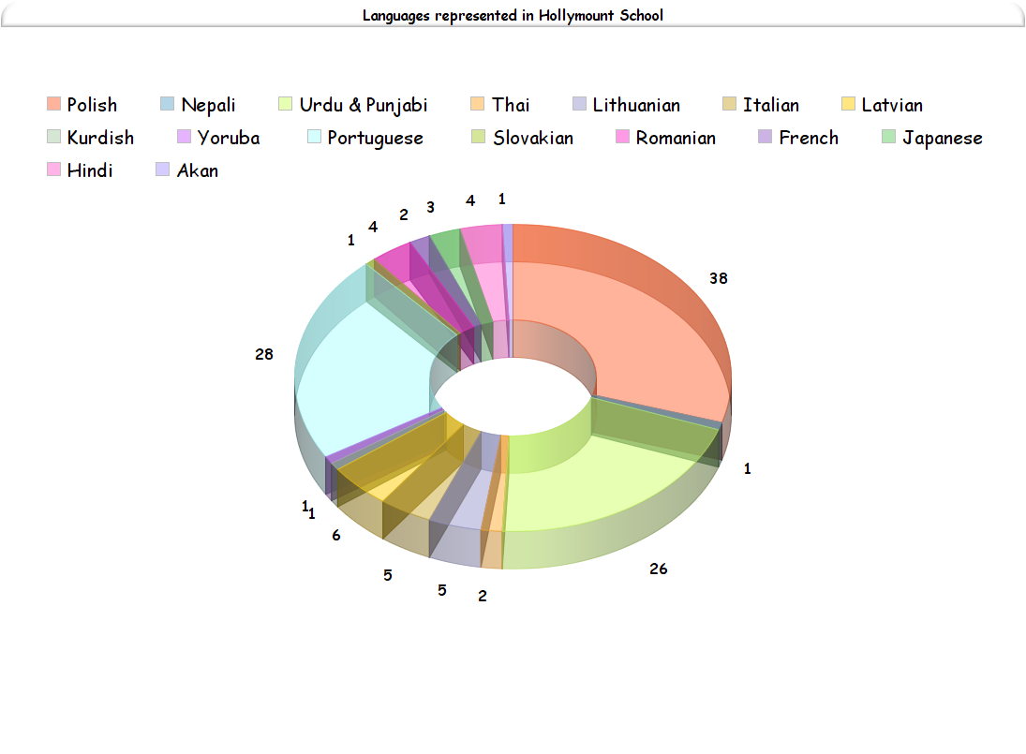
The largest group of EAL pupils are Polish (38), followed by
Portuguese (28) and Urdu and Punjabi (26).
We also have a number of isolated learners.

Slide 4
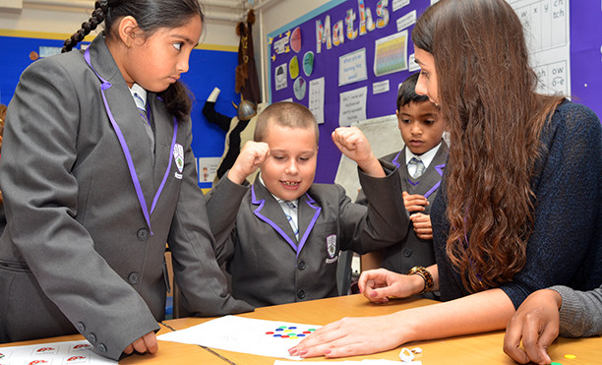
The school ethos is inclusive and welcomes children of all nationalities, languages, religions, cultures and backgrounds.
Year 4 pupils Zaima (whose family came from Pakistan) with Wiktor
(who is Polish) and Gaurav (who is from India).

Slide 5
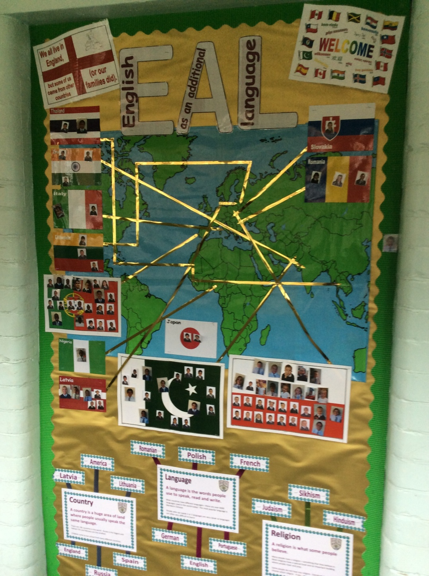
EAL strategies and
awareness are firmly
embedded in all elements
our school.
Well matched learning
opportunities and support
EAL displays
EAL assemblies
Specific EAL Year 6 transition
EAL Family Learning
Links with local high
school’s EAL departments

Slide 6
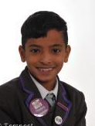
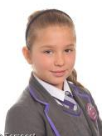
Young Translators
My name is Gaurav. My sister and I speak Hindi and English.
All our EAL children are taught to act as translators for other children
and their teachers and the skill involved in translation is highly
valued.
Children who are confident translators are chosen to be our official
‘Young Translators’ and show new EAL families around school and help
them understand letters and forms. In addition they also translate
between school staff and newly arrived children.
Although most of our Young Translators are in Years 5 and 6, our
youngest ever translator was just 4 years old!
My name is Viki. I speak Slovakian, Polish and English.

Slide 7
Staff provide high quality support for all EAL children through their different stages of English proficiency. Staff are enabled to do this via:
  Whole staff EAL training.
  Targeted training for NQTs, teachers and T.A s.
  In school support from school EAL co-ordinator.
  Liaison with collaborative learning expert Stuart Scott.
  Supportive and well informed senior management.
  This provision is monitored through learning walks and staff discussions at phase meetings and pupil progress meetings.
Provision for staff

Slide 8
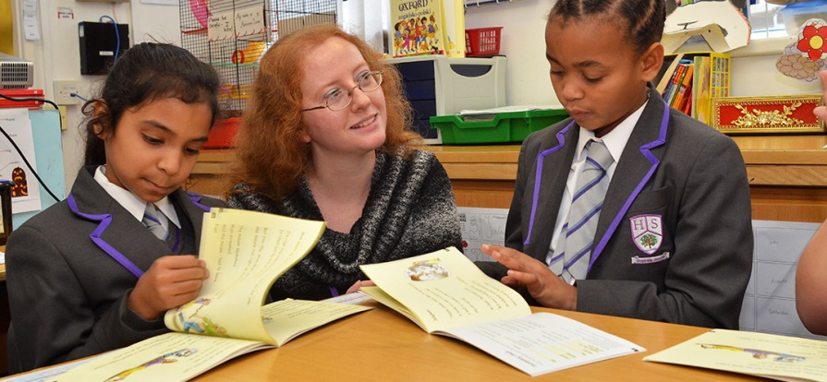
Like all children at Hollymount, EAL pupils are given targeted teaching and learning which is appropriate to their age and proficiency in English. Children causing concern in their progress or attainment and discussed during pupils progress meetings.
This year the whole school focus of Speaking and Listening has been particularly beneficial to our EAL learners.
Provision for children

Slide 9
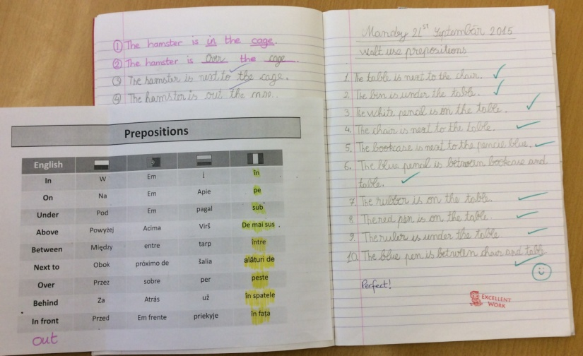
New Arrivals
Newly arrived children (those who have been in England for less than a year) are given an hour of dedicated intervention every day for the first year.
This is taught by the school EAL co-ordinator and specifically teaches the children the basic phonics, vocabulary and sentence structure they need to speak, read and write in English.
Example of work from first term of the EAL intervention class

Slide 10
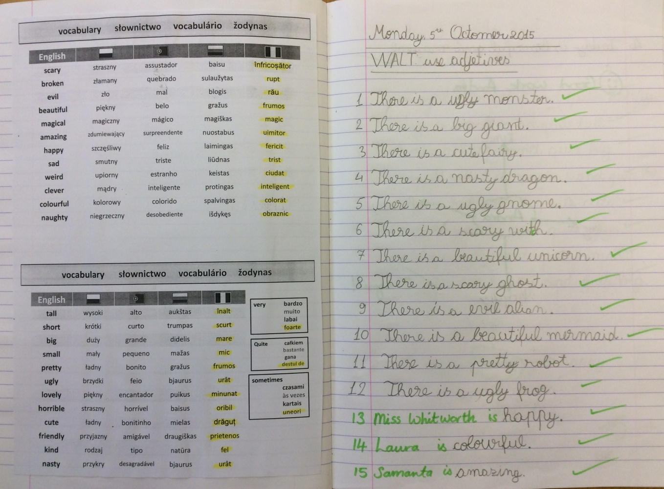
Home languages are
used to support
learning across the
school wherever
possible.
This values the
children’s culture and
prior learning and
enables them to access
far more of the curriculum.
The repetitive element of these interventions enables the children to
constantly practise the vocabulary they have been taught and
develop confidence in using their new language.

Slide 11
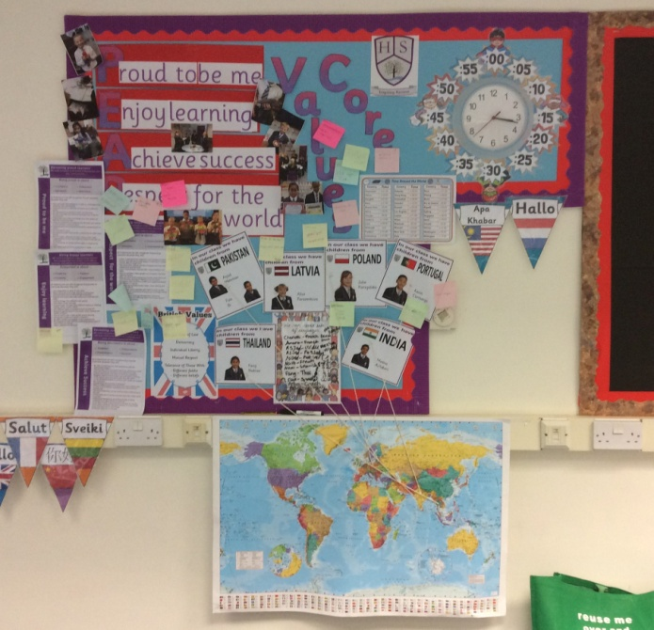
Home languages are valued and their use is encouraged across the
curriculum. Children are sometimes grouped by language so
discussion and collaborative learning can take place more easily.
We also have bilingual staff at Hollymount who provide
valuable support to our EAL children and families. Currently we
have adults who speak French, Polish, Portuguese, Romanian,
Russian, Urdu and Panjabi.
Bilingual staff:
Allow parents to access forms and letters.
Translate SATs papers.
Support Family Learning.
Provide support with high school applications.
Explain new situations to EAL children.
Support staff with newly arrived children.

Slide 12
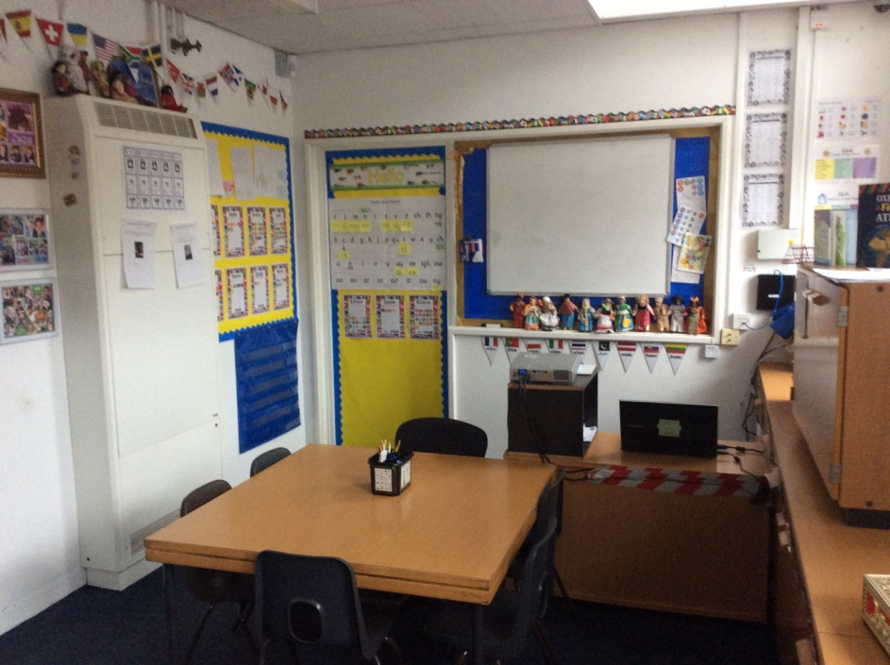
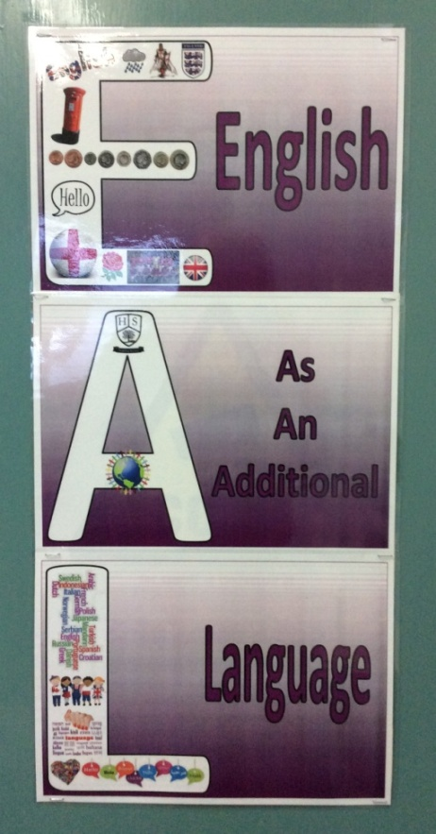
This is our EAL room.
EAL intervention and phonics
lessons take place here in addition
to providing a safe base for any EAL
child who needs help or support.
Most EAL children suffer from some form of culture
shock caused by the trauma of leaving their home
countries. Staff are aware of these issues and the
EAL co-ordinator provides pastoral support, alongside
class teachers, for those who need to talk or be
‘looked after’ during this time. The pastoral care
given to our EAL children is essential in enabling
them to thrive and achieve.

Slide 13
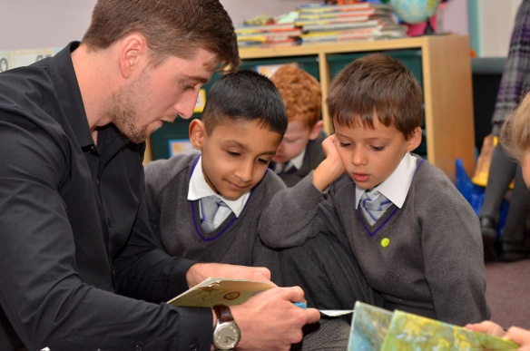
Advanced Learners
Improving English speakers (those who have been in England for one to three years) are supported within mainstream classes by their teachers, TAs and the EAL co-ordinator, who works with them several times a week and provides pre-teaching.
Advanced Learners (those who have been in England for over three years) are fully integrated into mainstream classes. Their teachers are aware that there will still be gaps in their English knowledge and explain new subject specific vocabulary as needed.

Slide 14
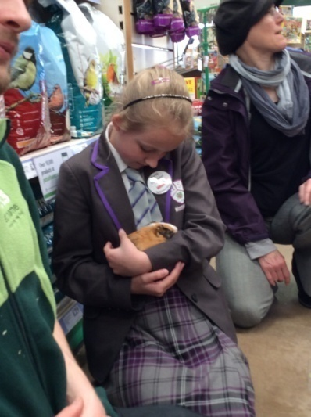
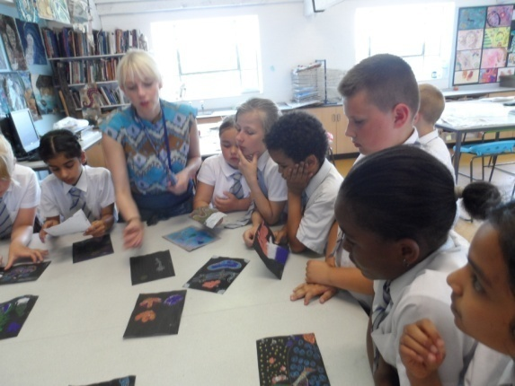
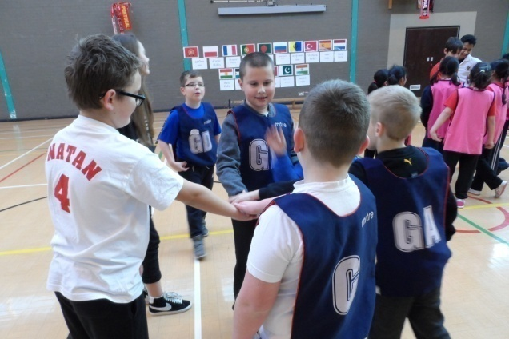
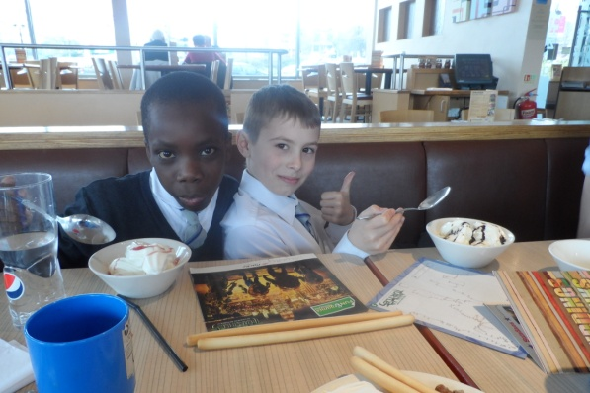
EAL Trips
In addition to attending class and whole school trips, our EAL children are also given opportunities to go on special EAL trips. These trips give the children a chance to use their speaking and listening skills with new people and develop their confidence.
We also have close link to our
local high school and take our
EAL children to meet their EAL
staff and pupils. These trips
have had a big impact on the
way the children view high
school and build their
confidence at this stressful
time.

Slide 15
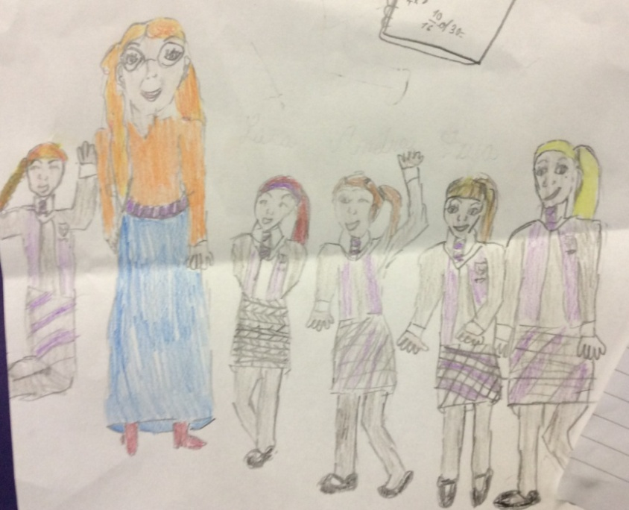
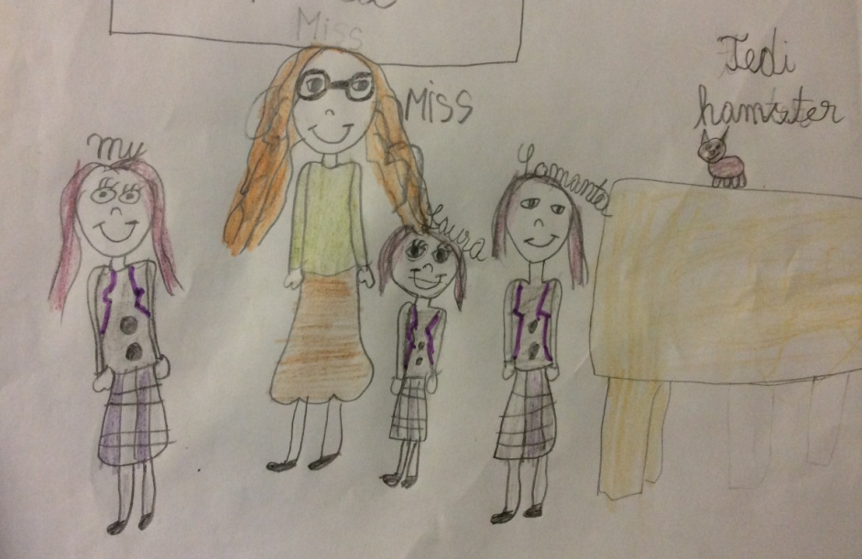
EAL has a very high focus amongst
our children – including for those whose
first language is English. All of our children
know who speaks an additional language
and many English children ask the EALs
to teach them a few words in their
languages.
Children are interested in each others
differences and like discussing and
finding out about other cultures.
There is respect and tolerance across
the school as our children see a
multicultural and multilingual school
as normal.
Drawn by two Romanian girls who joined the school in September.
They have very quickly settled in at Hollymount and are thriving.

Slide 16
EAL Success
Throughout our school EAL pupils make fantastic progress and attain well. At each data benchmark they attain in line with, or better than, all children nationally.

Slide 17

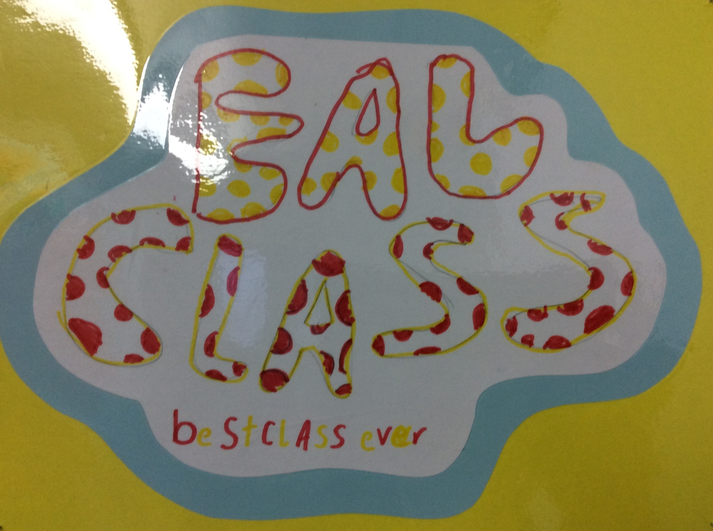
Drawn by a Year 4 Polish boy who had needed a lot of emotional support over the three years he was with us.

